Slide 1
Computability and Complexity
11-1
Complexity of Problems
Computability and Complexity
Andrei Bulatov

Slide 2
Computability and Complexity
11-2
Classifying Problems
We have seen that decision problems (and their associated
languages) can be classified into decidable and undecidable.
This result was obtained by Turing and others in the 1930’ —
before the invention of computers.
After the invention of computers, it became clear that it would be
useful to classify decidable problems, to distinguish harder problems
from easier problems
This led to the development of computational complexity theory
in the 1960’s and 1970’s

Slide 3
Computability and Complexity
11-3
The Aim
All
Languages
Decidable
Languages
“Easy” Problems
“Hard” Problems

Slide 4
Computability and Complexity
11-5
Complexity Measures
Every decidable problem has a set of algorithms (= TMs) that solve it.
What property of this set of algorithms could we measure to classify
the problem?
The difficulty of constructing such an algorithm?
The length of the shortest possible algorithm?
(Giving a static complexity measure².)
The efficiency of the most efficient possible algorithm?
(Giving a dynamic complexity measure.)
²This has proved useful for classifying the complexity of strings, where
it is called Kolmogorov complexity. See “Introduction to Kolmogorov Complexity
and its Applications”, Li and Vitani, 1993

Slide 5

Computability and Complexity
11-6
Dynamic Complexity Measures
A dynamic complexity measure is a numerical function that measures
the maximum resources used by an algorithm to compute the answer
to a given instance
To define a dynamic complexity measure we have to define for each possible algorithm M a numerical function on the same inputs

Slide 6


Computability and Complexity
11-8
Time Complexity
The most critical computational resource is often time, so the most useful complexity measure is often time complexity
If we take Turing Machine as our model of computation, then we can give a precise measure of the time resources used by a computation
Definition The time complexity of a Turing Machine T is the
function such that is the number of
steps taken by the computation T(x)
(Note that if T(x) does not halt, then is undefined.)

Slide 7


Computability and Complexity
11-9
Space Complexity
Another important computational resource is amount of “memory” used by an algorithm, that is space. The corresponding complexity measure is space complexity
As with time, if we take Turing Machine as our model of computation, then we can easily give a measure of the space resources used by a computation
Definition The space complexity of a Turing Machine T is the
function such that is the number of
distinct tape cells visited during the computation T(x)
(Note that if T(x) does not halt, then is undefined.)

Slide 8
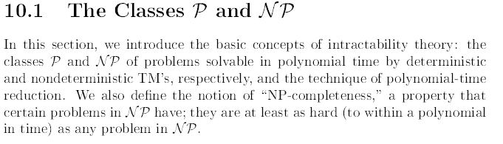
Class P - Example: Kruskal’s algorithm
Class NP – Example :Travelling salesman problem

Slide 9
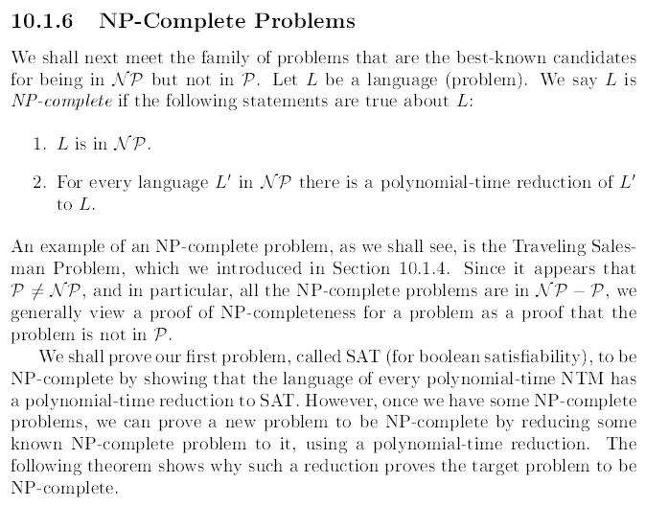

Slide 10
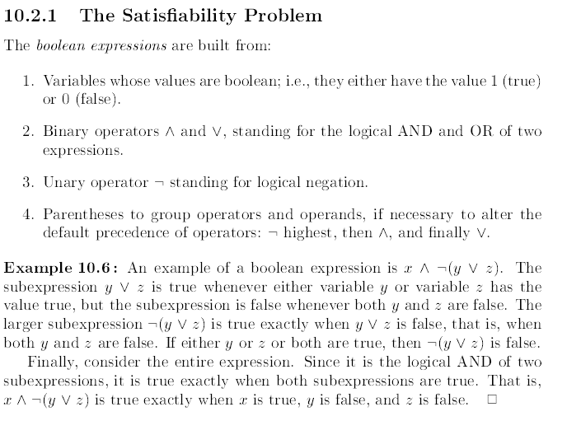

Slide 11
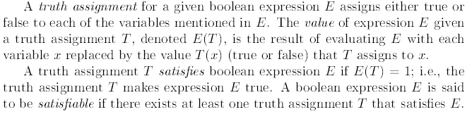

Slide 12
